Slide 1
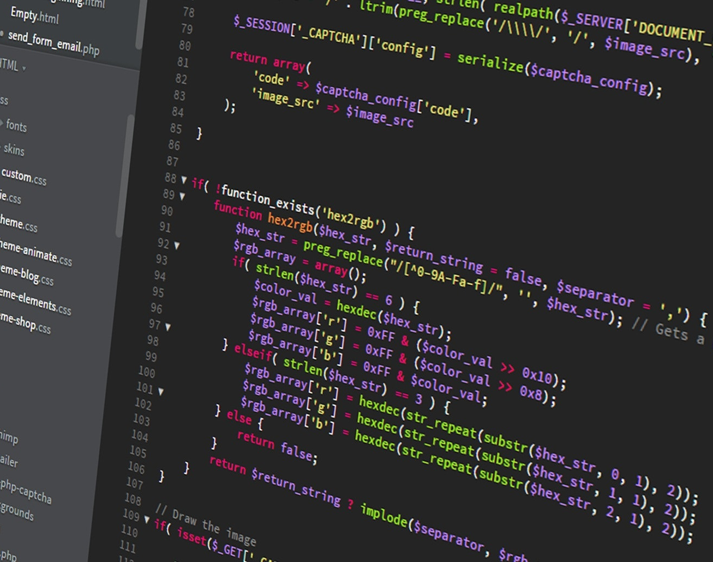
ICT 101 Introduction to the Internet and Web Development
Week 6 – CSS
Courtesy of Pixabay

Slide 2
Weekly Learning Goals
Read Chapter 18 to 21 of The Prescribed Text
Attend LECTORIAL
Perform practical Exercises

Slide 3

Week 6 Learning Outcomes
By the end of this week, you should be able to demonstrate:
Knowledge about using Cascading Style Sheets (CSS)

Slide 4
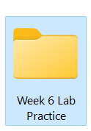
Week 6 Lab Practice
Create a folder: Week 6 Lab Practice

Slide 5
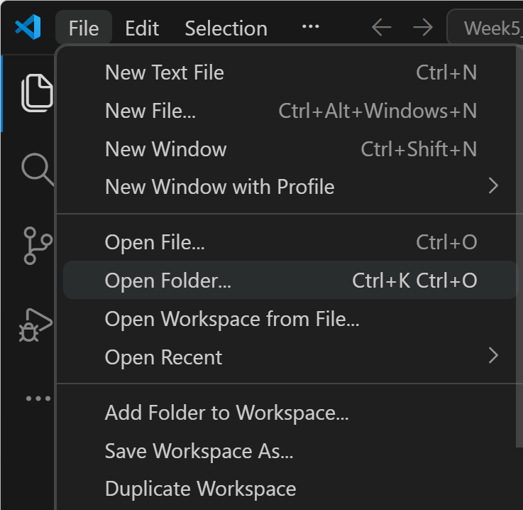
Week 6 Lab Practice
Open Visual Studio Code
Click on:
File → Open Folder...
A window will open
Go to where your folder is saved (e.g, C:\Week 6 Lab Practice)
Click on the folder >> Click Select Folder

Slide 6
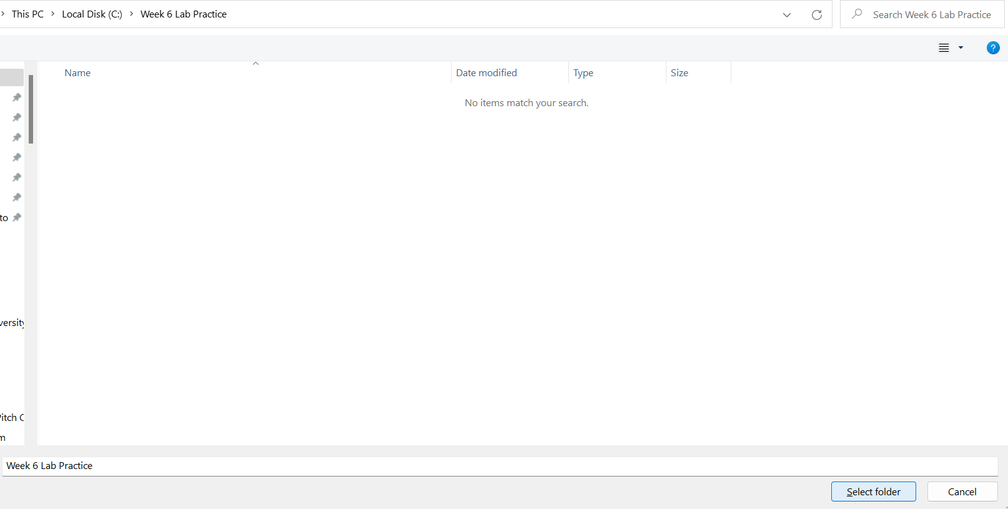
Week 6 Lab Practice
Select folder

Slide 7
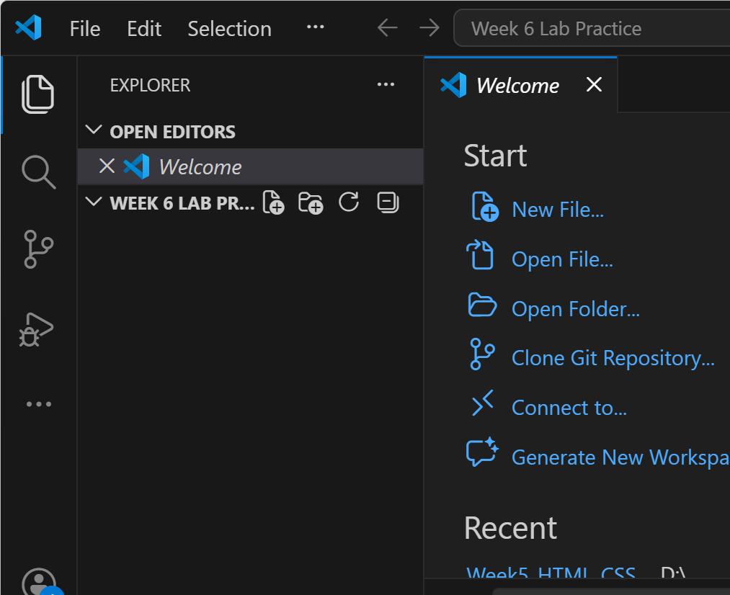
Week 6 Lab Practice
Now it will appear on the left under Explorer: Week 6 Lab Practice

Slide 8
Week 6 Lab Practice
Project goal
Create a horizontal navigation bar with:
Home
News
Dropdown
a drop-down menu showing:
Link 1
Link 2
Link 3
The red part is the active dropdown button, and the links appear when the mouse is placed over it.

Slide 9
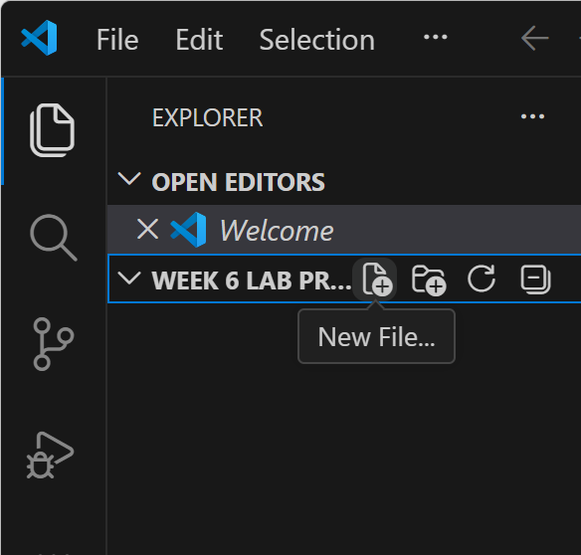
Week 6 Lab Practice
Step 1: Create the project folder
In Visual Studio Code:
Inside that folder, create a new file named:
Week6_index.html
You can keep everything in one file for this task.

Slide 10
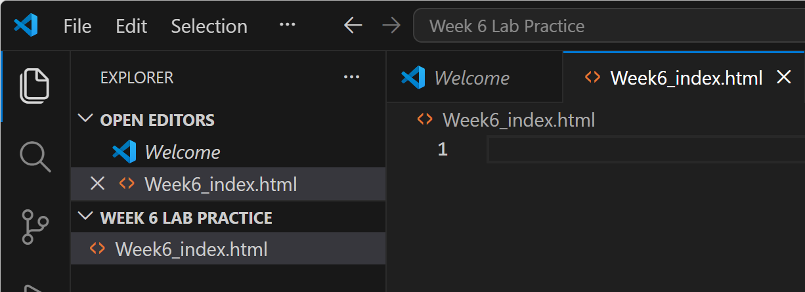
Week 6 Lab Practice
Step 1: Create the project folder
In Visual Studio Code:
Inside that folder, create a new file named:
Week6_index.html
You can keep everything in one file for this task.

Slide 11
Week 6 Lab Practice
Step 2: Write the HTML structure
Write this code first:
<!DOCTYPE html>
<html>
<head>
<title>Dropdown Navigation Bar</title>
<style>
</style>
</head>
<body>
</body>
</html>
Tells the browser this is an HTML5 document.

Slide 12
Week 6 Lab Practice
Step 2: Write the HTML structure
Write this code first:
<!DOCTYPE html>
<html>
<head>
<title>Dropdown Navigation Bar</title>
<style>
</style>
</head>
<body>
</body>
</html>
Starts the HTML page.

Slide 13
Week 6 Lab Practice
Step 2: Write the HTML structure
Write this code first:
<!DOCTYPE html>
<html>
<head>
<title>Dropdown Navigation Bar</title>
<style>
</style>
</head>
<body>
</body>
</html>
Contains information about the page, like title and CSS.

Slide 14
Week 6 Lab Practice
Step 2: Write the HTML structure
Write this code first:
<!DOCTYPE html>
<html>
<head>
<title>Dropdown Navigation Bar</title>
<style>
</style>
</head>
<body>
</body>
</html>
Sets the page title shown on the browser tab.

Slide 15
Week 6 Lab Practice
Step 2: Write the HTML structure
Write this code first:
<!DOCTYPE html>
<html>
<head>
<title>Dropdown Navigation Bar</title>
<style>
</style>
</head>
<body>
</body>
</html>
Sets the page title shown on the browser tab.

Slide 16
Week 6 Lab Practice
Step 2: Write the HTML structure
Write this code first:
<!DOCTYPE html>
<html>
<head>
<title>Dropdown Navigation Bar</title>
<style>
</style>
</head>
<body>
</body>
</html>
This is where we will write the CSS code.

Slide 17
Week 6 Lab Practice
Step 2: Write the HTML structure
Write this code first:
<!DOCTYPE html>
<html>
<head>
<title>Dropdown Navigation Bar</title>
<style>
</style>
</head>
<body>
</body>
</html>
Ends the head section.

Slide 18
Week 6 Lab Practice
Step 2: Write the HTML structure
Write this code first:
<!DOCTYPE html>
<html>
<head>
<title>Dropdown Navigation Bar</title>
<style>
</style>
</head>
<body>
</body>
</html>
Starts the visible part of the web page.

Slide 19
Week 6 Lab Practice
Step 2: Write the HTML structure
Write this code first:
<!DOCTYPE html>
<html>
<head>
<title>Dropdown Navigation Bar</title>
<style>
</style>
</head>
<body>
</body>
</html>
Ends the visible part.

Slide 20
Week 6 Lab Practice
Step 2: Write the HTML structure
Write this code first:
<!DOCTYPE html>
<html>
<head>
<title>Dropdown Navigation Bar</title>
<style>
</style>
</head>
<body>
</body>
</html>
Ends the HTML file.

Slide 21
Week 6 Lab Practice
Step 3: Add the navigation bar HTML
Now place this code inside the <body> section:
<body>
<div class="navbar">
<a href="#">Home</a>
<a href="#">News</a>
<div class="dropdown">
<button class="dropbtn">Dropdown</button>
<div class="dropdown-content">
<a href="#">Link 1</a>
<a href="#">Link 2</a>
<a href="#">Link 3</a>
</div>
</div>
</div>
</body>

Slide 22
Week 6 Lab Practice
Navigation bar container:
Creates a main box for the navigation bar.
<body>
<div class="navbar">
<a href="#">Home</a>
<a href="#">News</a>
<div class="dropdown">
<button class="dropbtn">Dropdown</button>
<div class="dropdown-content">
<a href="#">Link 1</a>
<a href="#">Link 2</a>
<a href="#">Link 3</a>
</div>
</div>
</div>
</body>

Slide 23
Week 6 Lab Practice
Navigation bar container:
Creates the Home link. href="#" means it does not go to another page yet.
<body>
<div class="navbar">
<a href="#">Home</a>
<a href="#">News</a>
<div class="dropdown">
<button class="dropbtn">Dropdown</button>
<div class="dropdown-content">
<a href="#">Link 1</a>
<a href="#">Link 2</a>
<a href="#">Link 3</a>
</div>
</div>
</div>
</body>

Slide 24
Week 6 Lab Practice
Navigation bar container:
Creates the News link.
<body>
<div class="navbar">
<a href="#">Home</a>
<a href="#">News</a>
<div class="dropdown">
<button class="dropbtn">Dropdown</button>
<div class="dropdown-content">
<a href="#">Link 1</a>
<a href="#">Link 2</a>
<a href="#">Link 3</a>
</div>
</div>
</div>
</body>

Slide 25
Week 6 Lab Practice
Dropdown section:
Creates a separate section for the dropdown menu.
<body>
<div class="navbar">
<a href="#">Home</a>
<a href="#">News</a>
<div class="dropdown">
<button class="dropbtn">Dropdown</button>
<div class="dropdown-content">
<a href="#">Link 1</a>
<a href="#">Link 2</a>
<a href="#">Link 3</a>
</div>
</div>
</div>
</body>

Slide 26
Week 6 Lab Practice
Dropdown section:
Creates the button named Dropdown.
<body>
<div class="navbar">
<a href="#">Home</a>
<a href="#">News</a>
<div class="dropdown">
<button class="dropbtn">Dropdown</button>
<div class="dropdown-content">
<a href="#">Link 1</a>
<a href="#">Link 2</a>
<a href="#">Link 3</a>
</div>
</div>
</div>
</body>

Slide 27
Week 6 Lab Practice
Dropdown section:
Creates a hidden box that will contain the dropdown links.
<body>
<div class="navbar">
<a href="#">Home</a>
<a href="#">News</a>
<div class="dropdown">
<button class="dropbtn">Dropdown</button>
<div class="dropdown-content">
<a href="#">Link 1</a>
<a href="#">Link 2</a>
<a href="#">Link 3</a>
</div>
</div>
</div>
</body>

Slide 28
Week 6 Lab Practice
Dropdown section:
These are the links that will appear when the user moves the mouse over the dropdown.
<body>
<div class="navbar">
<a href="#">Home</a>
<a href="#">News</a>
<div class="dropdown">
<button class="dropbtn">Dropdown</button>
<div class="dropdown-content">
<a href="#">Link 1</a>
<a href="#">Link 2</a>
<a href="#">Link 3</a>
</div>
</div>
</div>
</body>

Slide 29
Week 6 Lab Practice
Dropdown section:
Ends the dropdown content box.
<body>
<div class="navbar">
<a href="#">Home</a>
<a href="#">News</a>
<div class="dropdown">
<button class="dropbtn">Dropdown</button>
<div class="dropdown-content">
<a href="#">Link 1</a>
<a href="#">Link 2</a>
<a href="#">Link 3</a>
</div>
</div>
</div>
</body>

Slide 30
Week 6 Lab Practice
Dropdown section:
Ends the dropdown section.
<body>
<div class="navbar">
<a href="#">Home</a>
<a href="#">News</a>
<div class="dropdown">
<button class="dropbtn">Dropdown</button>
<div class="dropdown-content">
<a href="#">Link 1</a>
<a href="#">Link 2</a>
<a href="#">Link 3</a>
</div>
</div>
</div>
</body>

Slide 31
Week 6 Lab Practice
Dropdown section:
Ends the navigation bar.
<body>
<div class="navbar">
<a href="#">Home</a>
<a href="#">News</a>
<div class="dropdown">
<button class="dropbtn">Dropdown</button>
<div class="dropdown-content">
<a href="#">Link 1</a>
<a href="#">Link 2</a>
<a href="#">Link 3</a>
</div>
</div>
</div>
</body>

Slide 32
Week 6 Lab Practice
Step 5: Add the CSS styling
Now use this code inside the <style> section:
<style>
body {
margin: 0;
font-family: Arial, sans-serif;
}
.navbar {
overflow: hidden;
background-color: #333;
}
.navbar a {
float: left;
font-size: 18px;
color: white;
text-align: center;
padding: 14px 20px;
text-decoration: none;
}
.dropdown {
float: left;
overflow: hidden;
}
.dropdown .dropbtn {
font-size: 18px;
border: none;
outline: none;
color: white;
padding: 14px 20px;
background-color: red;
font-family: inherit;
margin: 0;
cursor: pointer;
}
.navbar a:hover,
.dropdown:hover .dropbtn {
background-color: red;
}
.dropdown-content {
display: none;
position: absolute;
background-color: white;
min-width: 160px;
box-shadow: 0px 8px 16px 0px rgba(0,0,0,0.2);
z-index: 1;
}
.dropdown-content a {
float: none;
color: black;
padding: 12px 16px;
text-decoration: none;
display: block;
text-align: left;
}
.dropdown-content a:hover {
background-color: #ddd;
}
.dropdown:hover .dropdown-content {
display: block;
}
</style>
Style for the whole page
body {
Applies style to the whole page.
margin: 0;
Removes extra empty space around the page.
font-family: Arial, sans-serif;
Sets the text style to Arial.
}
Ends the body style.

Slide 33
Week 6 Lab Practice
<style>
body {
margin: 0;
font-family: Arial, sans-serif;
}
.navbar {
overflow: hidden;
background-color: #333;
}
.navbar a {
float: left;
font-size: 18px;
color: white;
text-align: center;
padding: 14px 20px;
text-decoration: none;
}
.dropdown {
float: left;
overflow: hidden;
}
.dropdown .dropbtn {
font-size: 18px;
border: none;
outline: none;
color: white;
padding: 14px 20px;
background-color: red;
font-family: inherit;
margin: 0;
cursor: pointer;
}
.navbar a:hover,
.dropdown:hover .dropbtn {
background-color: red;
}
.dropdown-content {
display: none;
position: absolute;
background-color: white;
min-width: 160px;
box-shadow: 0px 8px 16px 0px rgba(0,0,0,0.2);
z-index: 1;
}
.dropdown-content a {
float: none;
color: black;
padding: 12px 16px;
text-decoration: none;
display: block;
text-align: left;
}
.dropdown-content a:hover {
background-color: #ddd;
}
.dropdown:hover .dropdown-content {
display: block;
}
</style>
Style for the navigation bar
.navbar {
Selects the main navigation bar.
overflow: hidden;
Keeps content inside the navbar neatly.
background-color: #333;
Gives the navbar a dark grey background.
}
Ends navbar style.

Slide 34
Week 6 Lab Practice
Style for navbar links
.navbar a {
Selects all links inside the navbar.
float: left;
Places links side by side from left to right.
font-size: 18px;
Makes the text size 18 pixels.
color: white;
.navbar a {
float: left;
font-size: 18px;
color: white;
text-align: center;
padding: 14px 20px;
text-decoration: none;
}
.dropdown {
float: left;
overflow: hidden;
}
.dropdown .dropbtn {
font-size: 18px;
border: none;
outline: none;
color: white;
padding: 14px 20px;
background-color: red;
font-family: inherit;
margin: 0;
cursor: pointer;
}
.navbar a:hover,
.dropdown:hover .dropbtn {
background-color: red;
}
.dropdown-content {
display: none;
position: absolute;
background-color: white;
min-width: 160px;
box-shadow: 0px 8px 16px 0px rgba(0,0,0,0.2);
z-index: 1;
}
.dropdown-content a {
float: none;
color: black;
padding: 12px 16px;
text-decoration: none;
display: block;
text-align: left;
}
.dropdown-content a:hover {
background-color: #ddd;
}
.dropdown:hover .dropdown-content {
display: block;
}
</style>

Slide 35
Week 6 Lab Practice
Makes the text color white.
text-align: center;
Centers the text inside each link box.
padding: 14px 20px;
Adds space inside the links to make them bigger.
text-decoration: none;
Removes the underline from links.
}
Ends link style.
.navbar a {
float: left;
font-size: 18px;
color: white;
text-align: center;
padding: 14px 20px;
text-decoration: none;
}
.dropdown {
float: left;
overflow: hidden;
}
.dropdown .dropbtn {
font-size: 18px;
border: none;
outline: none;
color: white;
padding: 14px 20px;
background-color: red;
font-family: inherit;
margin: 0;
cursor: pointer;
}
.navbar a:hover,
.dropdown:hover .dropbtn {
background-color: red;
}
.dropdown-content {
display: none;
position: absolute;
background-color: white;
min-width: 160px;
box-shadow: 0px 8px 16px 0px rgba(0,0,0,0.2);
z-index: 1;
}
.dropdown-content a {
float: none;
color: black;
padding: 12px 16px;
text-decoration: none;
display: block;
text-align: left;
}
.dropdown-content a:hover {
background-color: #ddd;
}
.dropdown:hover .dropdown-content {
display: block;
}
</style>

Slide 36
Week 6 Lab Practice
Style for dropdown container
.dropdown {
Selects the dropdown section.
float: left;
Places it next to Home and News.
overflow: hidden;
Keeps the content inside properly.
}
Ends dropdown container style.
.dropdown {
float: left;
overflow: hidden;
}
.dropdown .dropbtn {
font-size: 18px;
border: none;
outline: none;
color: white;
padding: 14px 20px;
background-color: red;
font-family: inherit;
margin: 0;
cursor: pointer;
}
.navbar a:hover,
.dropdown:hover .dropbtn {
background-color: red;
}
.dropdown-content {
display: none;
position: absolute;
background-color: white;
min-width: 160px;
box-shadow: 0px 8px 16px 0px rgba(0,0,0,0.2);
z-index: 1;
}
.dropdown-content a {
float: none;
color: black;
padding: 12px 16px;
text-decoration: none;
display: block;
text-align: left;
}
.dropdown-content a:hover {
background-color: #ddd;
}
.dropdown:hover .dropdown-content {
display: block;
}
</style>

Slide 37
Week 6 Lab Practice
Style for dropdown button
.dropdown .dropbtn {
Selects the button inside the dropdown.
font-size: 18px;
Sets the text size.
border: none;
Removes the button border.
outline: none;
Removes the outline line around the button.
color: white;
Makes button text white.
.dropdown .dropbtn {
font-size: 18px;
border: none;
outline: none;
color: white;
padding: 14px 20px;
background-color: red;
font-family: inherit;
margin: 0;
cursor: pointer;
}
.navbar a:hover,
.dropdown:hover .dropbtn {
background-color: red;
}
.dropdown-content {
display: none;
position: absolute;
background-color: white;
min-width: 160px;
box-shadow: 0px 8px 16px 0px rgba(0,0,0,0.2);
z-index: 1;
}
.dropdown-content a {
float: none;
color: black;
padding: 12px 16px;
text-decoration: none;
display: block;
text-align: left;
}
.dropdown-content a:hover {
background-color: #ddd;
}
.dropdown:hover .dropdown-content {
display: block;
}
</style>

Slide 38
Week 6 Lab Practice
padding: 14px 20px;
Adds space inside the button.
background-color: red;
Makes the button red.
font-family: inherit;
Uses the same font as the page.
margin: 0;
Removes extra outside space.
.dropdown .dropbtn {
font-size: 18px;
border: none;
outline: none;
color: white;
padding: 14px 20px;
background-color: red;
font-family: inherit;
margin: 0;
cursor: pointer;
}
.navbar a:hover,
.dropdown:hover .dropbtn {
background-color: red;
}
.dropdown-content {
display: none;
position: absolute;
background-color: white;
min-width: 160px;
box-shadow: 0px 8px 16px 0px rgba(0,0,0,0.2);
z-index: 1;
}
.dropdown-content a {
float: none;
color: black;
padding: 12px 16px;
text-decoration: none;
display: block;
text-align: left;
}
.dropdown-content a:hover {
background-color: #ddd;
}
.dropdown:hover .dropdown-content {
display: block;
}
</style>

Slide 39
Week 6 Lab Practice
cursor: pointer;
Shows a hand sign when mouse moves over the button.
}
Ends dropdown button style.
.dropdown .dropbtn {
font-size: 18px;
border: none;
outline: none;
color: white;
padding: 14px 20px;
background-color: red;
font-family: inherit;
margin: 0;
cursor: pointer;
}
.navbar a:hover,
.dropdown:hover .dropbtn {
background-color: red;
}
.dropdown-content {
display: none;
position: absolute;
background-color: white;
min-width: 160px;
box-shadow: 0px 8px 16px 0px rgba(0,0,0,0.2);
z-index: 1;
}
.dropdown-content a {
float: none;
color: black;
padding: 12px 16px;
text-decoration: none;
display: block;
text-align: left;
}
.dropdown-content a:hover {
background-color: #ddd;
}
.dropdown:hover .dropdown-content {
display: block;
}
</style>

Slide 40
Week 6 Lab Practice
Hover effect
.navbar a:hover, .dropdown:hover .dropbtn {
Applies style when the mouse is over a link or the dropdown button.
background-color: red;
Changes background color to red.
}
Ends hover style.
.navbar a:hover,
.dropdown:hover .dropbtn {
background-color: red;
}
.dropdown-content {
display: none;
position: absolute;
background-color: white;
min-width: 160px;
box-shadow: 0px 8px 16px 0px rgba(0,0,0,0.2);
z-index: 1;
}
.dropdown-content a {
float: none;
color: black;
padding: 12px 16px;
text-decoration: none;
display: block;
text-align: left;
}
.dropdown-content a:hover {
background-color: #ddd;
}
.dropdown:hover .dropdown-content {
display: block;
}
</style>

Slide 41
Week 6 Lab Practice
.dropdown-content {
display: none;
position: absolute;
background-color: white;
min-width: 160px;
box-shadow: 0px 8px 16px 0px rgba(0,0,0,0.2);
z-index: 1;
}
.dropdown-content a {
float: none;
color: black;
padding: 12px 16px;
text-decoration: none;
display: block;
text-align: left;
}
.dropdown-content a:hover {
background-color: #ddd;
}
.dropdown:hover .dropdown-content {
display: block;
}
</style>
Hidden dropdown menu box
.dropdown-content {
Selects the box that contains Link 1, Link 2, and Link 3.
display: none;

Slide 42
Week 6 Lab Practice
.dropdown-content {
display: none;
position: absolute;
background-color: white;
min-width: 160px;
box-shadow: 0px 8px 16px 0px rgba(0,0,0,0.2);
z-index: 1;
}
.dropdown-content a {
float: none;
color: black;
padding: 12px 16px;
text-decoration: none;
display: block;
text-align: left;
}
.dropdown-content a:hover {
background-color: #ddd;
}
.dropdown:hover .dropdown-content {
display: block;
}
</style>
Hides the dropdown menu at first.
position: absolute;
Places the menu in an exact position under the button.

Slide 43
Week 6 Lab Practice
.dropdown-content {
display: none;
position: absolute;
background-color: white;
min-width: 160px;
box-shadow: 0px 8px 16px 0px rgba(0,0,0,0.2);
z-index: 1;
}
.dropdown-content a {
float: none;
color: black;
padding: 12px 16px;
text-decoration: none;
display: block;
text-align: left;
}
.dropdown-content a:hover {
background-color: #ddd;
}
.dropdown:hover .dropdown-content {
display: block;
}
</style>
background-color: white;
Makes the dropdown background white.
min-width: 160px;
Sets the minimum width of the dropdown box.

Slide 44
Week 6 Lab Practice
.dropdown-content {
display: none;
position: absolute;
background-color: white;
min-width: 160px;
box-shadow: 0px 8px 16px 0px rgba(0,0,0,0.2);
z-index: 1;
}
.dropdown-content a {
float: none;
color: black;
padding: 12px 16px;
text-decoration: none;
display: block;
text-align: left;
}
.dropdown-content a:hover {
background-color: #ddd;
}
.dropdown:hover .dropdown-content {
display: block;
}
</style>
box-shadow: 0px 8px 16px 0px rgba(0,0,0,0.2);
Adds a shadow effect under the dropdown box.

Slide 45
Week 6 Lab Practice
.dropdown-content {
display: none;
position: absolute;
background-color: white;
min-width: 160px;
box-shadow: 0px 8px 16px 0px rgba(0,0,0,0.2);
z-index: 1;
}
.dropdown-content a {
float: none;
color: black;
padding: 12px 16px;
text-decoration: none;
display: block;
text-align: left;
}
.dropdown-content a:hover {
background-color: #ddd;
}
.dropdown:hover .dropdown-content {
display: block;
}
</style>
z-index: 1;
Keeps the menu on top of other content.
}
Ends dropdown content style.

Slide 46
Week 6 Lab Practice
Style for dropdown links
.dropdown-content a {
Selects links inside the dropdown box.
float: none;
Stops the links from sitting side by side.
color: black;
Makes the text black.
padding: 12px 16px;
Adds space inside each link.
.dropdown-content a {
float: none;
color: black;
padding: 12px 16px;
text-decoration: none;
display: block;
text-align: left;
}
.dropdown-content a:hover {
background-color: #ddd;
}
.dropdown:hover .dropdown-content {
display: block;
}
</style>

Slide 47
Week 6 Lab Practice
text-decoration: none;
Removes underline.
display: block;
Makes each link take a full line.
text-align: left;
Aligns text to the left.
}
Ends dropdown link style.
.dropdown-content a {
float: none;
color: black;
padding: 12px 16px;
text-decoration: none;
display: block;
text-align: left;
}
.dropdown-content a:hover {
background-color: #ddd;
}
.dropdown:hover .dropdown-content {
display: block;
}
</style>

Slide 48
Week 6 Lab Practice
Hover effect for dropdown links
.dropdown-content a:hover {
Applies style when mouse is over dropdown links.
background-color: #ddd;
Changes the background to light grey.
}
Ends hover style.
.dropdown-content a:hover {
background-color: #ddd;
}
.dropdown:hover .dropdown-content {
display: block;
}
</style>

Slide 49
Week 6 Lab Practice
Show dropdown on hover
.dropdown:hover .dropdown-content {
When the mouse is over the dropdown section, select the hidden dropdown menu.
display: block;
Shows the hidden menu.
}
Ends the rule.
.dropdown-content a:hover {
background-color: #ddd;
}
.dropdown:hover .dropdown-content {
display: block;
}
</style>

Slide 50
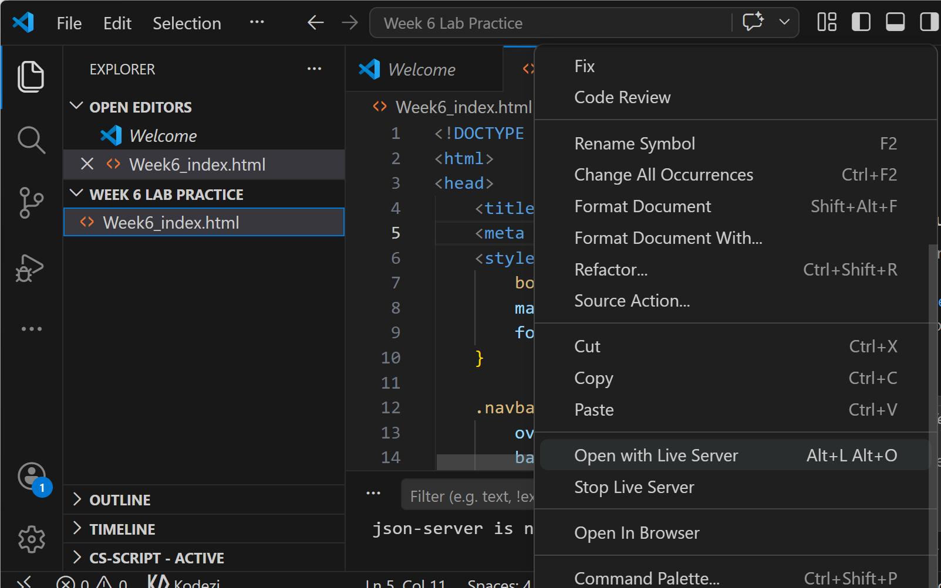
Week 6 Lab Practice
Right-click the file
Choose Open with Live Server if Live Server is installed or
Open the file directly in your browser by double-clicking it
When you move your mouse over Dropdown, the menu should appear

Slide 51
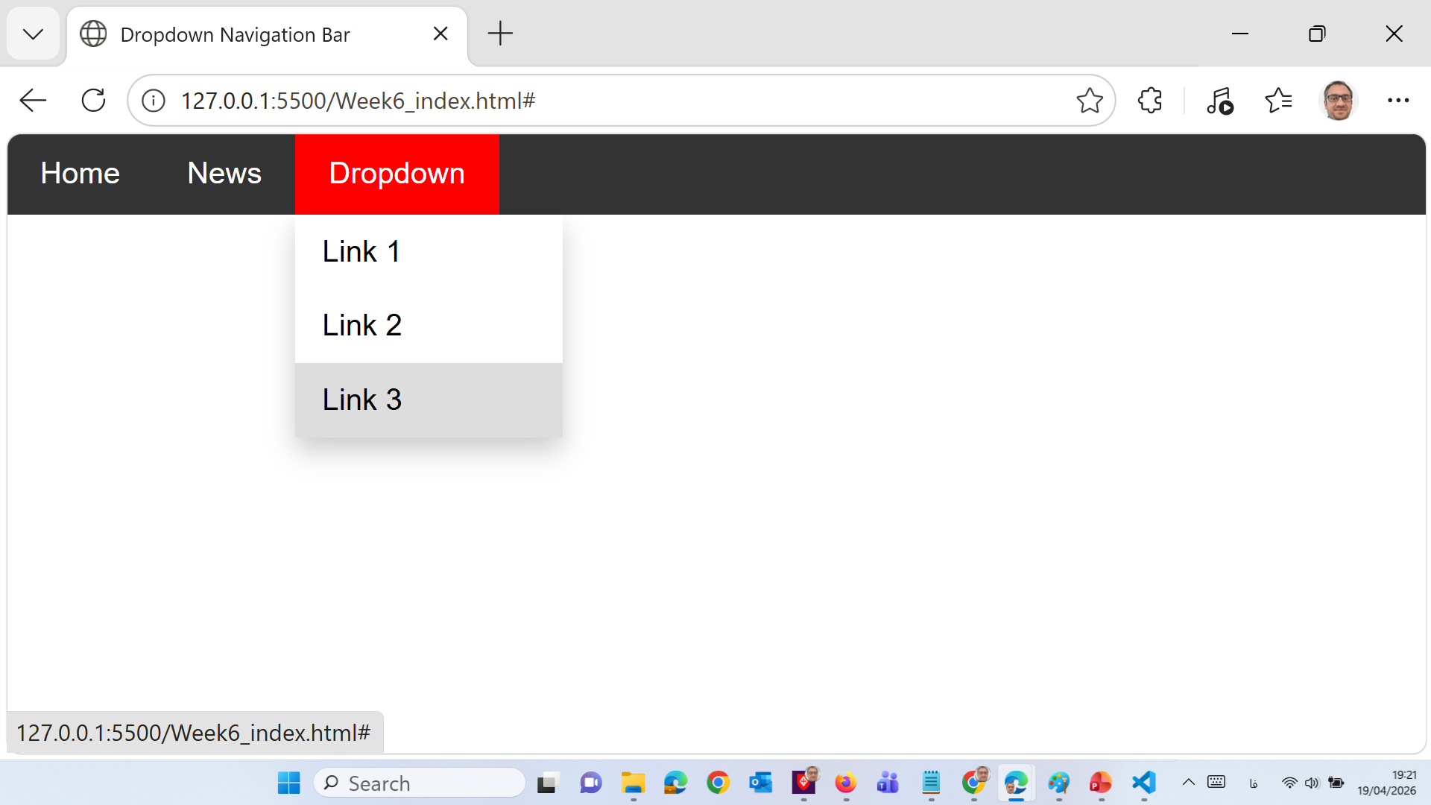
Week 6 Lab Practice

Slide 52
Week 6 Lab Practice
This project creates a horizontal navigation bar using HTML and CSS. The HTML is used to create the links and dropdown menu. The CSS is used to style the menu, set colors, align items, and show the dropdown links when the mouse hovers over the dropdown button.

Slide 53
Today’s Webinar
CSS
Pseudo-classes and Pseudo-elements
Navigation bar using CSS
Attribute Selectors in CSS
Forms in CSS
Website Layout using CSS

Slide 54
CSS Pseudo-classes
A pseudo-class is used to define a special state of an element.
For example, it can be used to:
Style an element when a user mouses over it
Style visited and unvisited links differently
Style an element when it gets focus
The syntax of pseudo-classes
selector:pseudo-class
{ property: value; }
https://www.w3schools.com
Notes:
In CSS, a pseudo-class is a keyword that is used to define a special state of an element. Pseudo-classes are used to select elements based on their state or position in relation to the document, user interaction, or other factors.
Some common examples of CSS pseudo-classes include:
:hover - selects an element when the user hovers over it with the mouse
:active - selects an element when it is being clicked or activated
:visited - selects a link that has been visited by the user
:focus - selects an element when it has focus, such as when a user clicks on an input field
:nth-child - selects elements based on their position within a parent element
:first-child - selects the first child element of a parent element
:last-child - selects the last child element of a parent element
Pseudo-classes can be very useful for adding dynamic effects and interactivity to a web page. They can also be combined with other CSS selectors to create more specific and powerful styles

Slide 55
Anchor Pseudo-classes
<!DOCTYPE html>
<html>
<head>
<style>
/* unvisited link */ commented section
a:link {
color: red;
}
/* visited link */ commented section
a:visited {
color: green;
}
/* mouse over link */ commented section
a:hover {
color: hotpink; }
/* selected link */ commented section
a:active {
color: blue;
}
</style>
</head>
<body>
<h2>CSS Links</h2>
<p><b><a href="http://www.sistc.nsw.edu.au" target="_blank">This is a link</a></b></p>
<p><b>Note:</b> a:hover MUST come after a:link and a:visited in the CSS definition in order to be effective.</p>
<p><b>Note:</b> a:active MUST come after a:hover in the CSS definition in order to be effective.</p>
</body>
</html>
https://www.w3schools.com
Notes:
In CSS, there are several pseudo-classes that are specifically related to anchor elements (also known as hyperlinks). These pseudo-classes allow you to style different states of the anchor element, depending on its interaction with the user. Some common anchor pseudo-classes include:

Slide 56
Hover on <div>
<!DOCTYPE html>
<html>
<head>
<style>
div {
background-color: green;
color: white;
padding: 25px;
text-align: center;
}
div:hover {
background-color: blue;
}
</style>
</head>
<body>
<p>Mouse over the div element below to change its background color:</p>
<div>Mouse Over Me</div>
</body>
</html>
https://www.w3schools.com

Slide 57
Hover on <P>
<!DOCTYPE html>
<html>
<head>
<style>
p {
display: none;
background-color: yellow;
padding: 20px;
}
div:hover p {
display: block;
}
</style>
</head>
<body>
<div>Hover over me to show the p element
<p>Tada! Here I am!</p>
</div>
</body>
</html>
https://www.w3schools.com

Slide 58
:focus Pseudo-Class
<!DOCTYPE html>
<html>
<head>
<style>
input:focus {
background-color: yellow;
}
</style>
</head>
<body>
<form>
First name: <input type="text" name="fname"><br>
Last name: <input type="text" name="lname"><br>
<input type="submit" value="Submit">
</form>
</body>
</html>
https://www.w3schools.com

Slide 59
Combining CSS Classes and Pseudo-classes
<!DOCTYPE html>
<html>
<head>
<style>
.highlight:hover {
color: Red;}
</style>
</head>
<body>
<h2>Pseudo-classes and CSS Classes</h2>
<p>When you hover over the first link below, it will change color:</p>
<p><a class="highlight" href="css_syntax.html">CSS Syntax</a></p>
<p><a href="default.html">CSS Tutorial</a></p>
</body>
</html>
https://www.w3schools.com

Slide 60
CSS Pseudo-elements
A CSS pseudo-element is used to style specified parts of an element.
For example, it can be used to:
Style the first letter, or line, of an element
Insert content before, or after, the content of an element
selector::pseudo-element
{ property: value; }
https://www.w3schools.com
Notes:
In CSS, a pseudo-element is a keyword that is used to style a specific part of an element. Pseudo-elements allow you to add content or style to parts of an element that are not part of the actual document structure. Pseudo-elements are indicated with a double colon (::) notation.
Some common CSS pseudo-elements include:
::before - creates a pseudo-element that is inserted before the content of an element
::after - creates a pseudo-element that is inserted after the content of an element
::first-letter - selects the first letter of the content in an element
::first-line - selects the first line of the content in an element
Here's an example of how to use the ::before pseudo-element to insert content before an element:

Slide 61
::First-line Pseudo-element
<!DOCTYPE html>
<html>
<head>
<style>
p::first-line {
color: Blue;
font-variant: small-caps; }
</style>
</head>
<body>
<p>You can use the ::first-line pseudo-element to add a special effect to the first line of a text. <br>Some more text. And even more, and more, and more, and more, and more.</p>
</body> </html>
https://www.w3schools.com

Slide 62
::First-letter Pseudo-element
<!DOCTYPE html>
<html>
<head>
<style>
p::first-letter {
color: Red;
font-size: xx-large;
}
</style>
</head>
<body>
<p>You can use the ::first-letter pseudo-element to add a special effect to the first character of a text!</p>
</body>
</html>
https://www.w3schools.com

Slide 63
:: Selection Pseudo-element
<!DOCTYPE html>
<html>
<head>
<style>
P::selection
{
color: red;
background: yellow;
}
</style>
</head>
<body>
<h1>Select some text on this page:</h1>
<p>This is a paragraph.</p>
<div>This is some text in a div element.</div>
</body>
</html>
https://www.w3schools.com

Slide 64
Pseudo-elements and CSS Classes
<!DOCTYPE html>
<html>
<head>
<style>
.intro::first-letter {
color: Red;
font-size: 200%; }
</style>
</head>
<body>
<p class="intro">This is an introduction.</p>
<p>This is a paragraph with some text. A bit more text even.</p>
</body>
</html>
https://www.w3schools.com

Slide 65
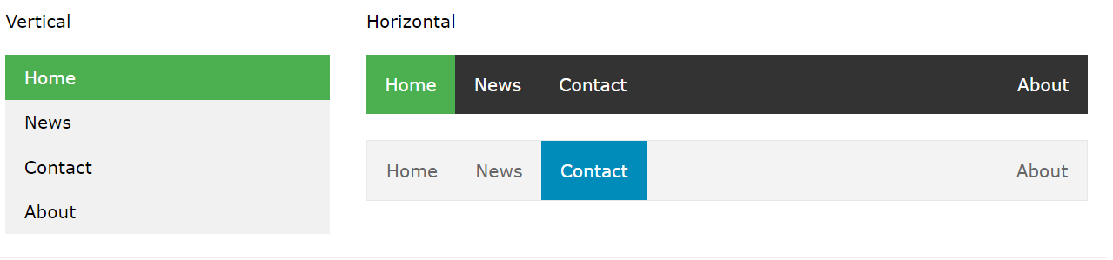
CSS Navigation Bar
Having easy-to-use navigation is important for any web site.
With CSS you can make good-looking navigation bars.
https://www.w3schools.com

Slide 66
Vertical Navigation Bar
</head>
<body>
<ul>
<li><a href="#home">Home</a></li>
<li><a href="#news">News</a></li>
<li><a href="#contact">Contact</a></li>
<li><a href="#about">About</a></li>
</ul>
</body>
</html>
<!DOCTYPE html>
<html>
<head>
<style>
ul {
list-style-type: none;
margin: 20px;
padding: 20px;
}
li a {
display: block;
width: 60px;
background-color: Red;
}
</style>
https://www.w3schools.com
Notes:
A navigation bar is an essential part of a website that helps visitors navigate between different pages or sections of the site. In CSS, you can create a navigation bar by styling a list of links with some specific styles.
Here's an example of how to create a basic navigation bar using an unordered list:

Slide 67
Vertical Navigation Bar Examples
<!DOCTYPE html>
<html>
<head>
<style>
ul {
list-style-type: none;
margin: 0;
padding: 0;
width: 100px;
background-color: Black;
}
li a {
display: block;
color: Red;
padding: 20px;
text-decoration: underline;}
</style>
</head>
<body>
<h2>Vertical Navigation Bar</h2>
<ul>
<li><a href="#home">Home</a></li>
<li><a href="#news">News</a></li>
<li><a href="#contact">Contact</a></li>
<li><a href="#about">About</a></li>
</ul>
</body>
</html>
https://www.w3schools.com

Slide 68
Horizontal Navigation Bar
<!DOCTYPE html>
<html>
<head>
<style>
ul {
list-style-type: none;
margin: 0;
padding: 0;
}
li {
display: inline;
}
</style>
</head>
<body>
<ul>
<li><a href="#home">Home</a></li>
<li><a href="#news">News</a></li>
<li><a href="#contact">Contact</a></li>
<li><a href="#about">About</a></li>
</ul>
</body>
</html>
https://www.w3schools.com

Slide 69
Horizontal Navigation Bar Example
<!DOCTYPE html>
<html>
<head>
<style>
ul {
list-style-type: none;
margin: 0;
padding: 0;}
li {
float : left;}
li a {
display: block;
color: Red;
text-align: center;
padding: 14px 16px;
text-decoration: none;
background-color: black;}
li a:hover {
background-color: yellow;
}
</style>
</head>
<body>
<ul>
<li><a href="#home">Home</a></li>
<li><a href="#news">News</a></li>
<li><a href="#contact">Contact</a></li>
<li><a href="#about">About</a></li>
</ul>
</body>
</html>
https://www.w3schools.com

Slide 70
Fixed Horizontal Navigation Bar Example
<!DOCTYPE html>
<html>
<head>
<style>
body {
margin:0;}
ul {
list-style-type: none; margin: 0;padding: 0; background-color: Grey; position: fixed; top: 0; width: 100%;}
li {float: left;}
li a {display: block; color: white; text-align: center; padding: 14px 16px; text-decoration: none;}
div{background-color: Green;margin-top:8px;padding:20px;}
</style>
</head><body>
<ul>
<li><a class="active" href="#home">Home</a></li>
<li><a href="#news">News</a></li>
<li><a href="#contact">Contact</a></li>
<li><a href="#about">About</a></li>
</ul>
<div>
<h1>Fixed Top Navigation Bar</h1>
<h2>The Shah Family is number 1</h2>
<p>Some text some text some text some text..</p>
<br><br><br><br><br><br><br><br><br><br><br><br><br><br><br><br><br><br><br><br><br><br><br><br><br><br><br><br><br><br><br><br>
<br><br><br><br><br><br><br><br><br><br><br><br><br><br><br><br><br><br><br><br><br><br><br><br><br><br><br><br><br><br><br><br>
</div>
</body></html>
https://www.w3schools.com

Slide 71
Image Gallery in CSS
<!DOCTYPE html>
<html>
<head>
<style>
div.gallery {
margin: 5px;
border: 1px solid Black;
float: left;
width: 180px;
}div.gallery:hover {
border: 1px solid Red;
}div.gallery img {
width: 100%;
height: 100%;
}div.desc {
padding: 15px;
text-align: center;
}</style></head><body>
<div class="gallery">
<a href="Aus-Koala.jpg">
<img src="Aus-Koala.jpg" alt="Koala">
</a>
<div class="desc">Add a description of the image here</div>
</div>
<div class="gallery">
<a href="Aus-kangaroo.jpg">
<img src="Aus-kangaroo.jpg" alt="Kangaroo">
</a>
<div class="desc">Add a description of the image here</div>
</div>
<div class="gallery">
<a href="Aus-Uluru.jpg">
<img src="Aus-Uluru.jpg" alt="Uluru">
</a>
<div class="desc">Add a description of the image here</div>
</div>
</body>
</html>
https://www.w3schools.com

Slide 72
CSS Attribute Selectors
The [attribute] selector is used to select elements with a specified attribute.
For example
Select all <a> elements with a target attribute
a[target]
{ background-color: yellow; }
https://www.w3schools.com
Notes:
CSS attribute selectors are used to select elements based on the value of their attributes. There are several types of attribute selectors in CSS:
[attribute]: Selects all elements that have the specified attribute, regardless of its value.
[attribute=value]: Selects all elements that have the specified attribute with a value exactly equal to the given value.
[attribute^=value]: Selects all elements that have the specified attribute with a value that begins with the given value.
[attribute$=value]: Selects all elements that have the specified attribute with a value that ends with the given value.
[attribute*=value]: Selects all elements that have the specified attribute with a value that contains the given value.
Here's an example of how to use attribute selectors in CSS:

Slide 73
CSS Attribute Selectors
<!DOCTYPE html>
<html>
<head>
<style>
a[target] {
background-color: yellow;
}
</style>
</head>
<body>
<h2>CSS [attribute] Selector</h2>
<p>The links with a target attribute gets a yellow background:</p>
<a href="https://www.w3schools.com">w3schools.com</a>
<a href="http://www.disney.com" target="_blank">disney.com</a>
<a href="http://www.wikipedia.org" target="_top">wikipedia.org</a>
</body>
</html>
https://www.w3schools.com

Slide 74
Other CSS Attribute Selectors
[attribute="value"] Selector
[attribute*="value"] Selector
[attribute$="value"]Selector
[attribute^="value"] Selector
https://www.w3schools.com

Slide 75
[attribute="value"] Selector
<!DOCTYPE html>
<html>
<head>
<style>
a[target=_blank] {
background-color: yellow;
}
</style>
</head>
<body>
<h2>CSS [attribute="value"] Selector</h2>
<p>The link with target="_blank" gets a yellow background:</p>
<a href="https://www.w3schools.com">w3schools.com</a>
<a href="http://www.disney.com" target="_blank">disney.com</a>
<a href="http://www.wikipedia.org">wikipedia.org</a>
</body></html>
The [attribute="value"] selector is used to select elements with a specified attribute and value.
https://www.w3schools.com

Slide 76
[attribute*="value"] Selector
<!DOCTYPE html>
<html>
<head>
<style>
[class*="te"] {
background: yellow;}
</style>
</head>
<body>
<h2>CSS [attribute*="value"] Selector</h2>
<div class="first_test">The first div element.</div>
<div class="second">The second div element.</div>
<div class="my-test">The third div element.</div>
<p class="my">This is some text in a paragraph.</p>
</body></html>
The [attribute*="value"] selector is used to select elements whose attribute value contains a specified value.
Notes:
In the example above, the [class*=”te"] selector selects all elements that have a class attribute containing the word "example". In this case, it selects the h1 element with class="example-header", the p element with class="example-paragraph", and the li elements with class="example-list-item". The color of the text inside these elements will be red due to the CSS rule color: red;.

Slide 77
[attribute$="value"]Selector
<!DOCTYPE html>
<html>
<head>
<style>
[class$="test"] {
background: yellow;
}
</style>
</head>
<body>
<h2>CSS [attribute$="value"] Selector</h2>
<div class="first_test">The first div element.</div>
<div class="second">The second div element.</div>
<div class="my-test">The third div element.</div>
<p class="my">This is some text in a paragraph.</p>
</body></html>
The [attribute$="value"] selector is used to select elements whose attribute value ends with a specified value.
https://www.w3schools.com
Notes:
The code you have provided is a CSS selector that selects an HTML element based on the value of its attribute. Here's a breakdown of the selector:
attribute is the name of the attribute you want to select. For example, if you want to select all elements with a "data-id" attribute, you would replace "attribute" with "data-id".
value is the value of the attribute you want to select. For example, if you want to select all elements with a "data-id" attribute that has a value of "123", you would replace "value" with "123".
The = symbol is a CSS attribute selector operator that selects elements that have an attribute with a value that exactly matches the specified value.
So, the full selector attribute$="value" would select all elements that have an attribute named "attribute" with a value of "value".

Slide 78
[attribute^="value"] Selector
<!DOCTYPE html>
<html>
<head>
<style>
[class^="top"] {
background: yellow;
}
</style>
</head>
<body>
<h2>CSS [attribute^="value"] Selector</h2>
<h1 class="top-header">Welcome</h1>
<p class="top-text">Hello world!</p>
<p class="content">Are you learning CSS?</p>
</body>
</html>
The [attribute^="value"] selector is used to select elements whose attribute value begins with a specified value.
https://www.w3schools.com
Notes:
The CSS selector [attribute^="value"] is used to select HTML elements that have an attribute whose value starts with a specific string "value". Here's a breakdown of the selector:
attribute is the name of the attribute you want to select. For example, if you want to select all elements with a "data-id" attribute, you would replace "attribute" with "data-id".
^= is a CSS selector operator that selects elements where the attribute value starts with the specified value.
value is the string you want the attribute value to start with. For example, if you want to select all elements with a "data-id" attribute that starts with the string "user-", you would replace "value" with "user-".
So, the selector [attribute^="value"] would select all HTML elements that have an attribute named "attribute" with a value that starts with the string "value". For example, the selector [class^="my-class"] would select all elements with a class attribute that starts with "my-class".

Slide 79
Forms in CSS
<!DOCTYPE html>
<html>
<style> input[type=text], select {
width: 100%;
padding: 12px 20px;
margin: 8px 0;
display: inline-block;
border: 1px solid Grey;
box-sizing: border-box;
} input[type=submit] {
width: 100%;background-color: Green;
color: white;padding: 14px 20px;
margin: 8px 0;border: none;
border-radius: 4px; cursor: pointer;
}
input[type=submit]:hover {
background-color: Red;
}
div {
border-radius: 5px;
background-color: Grey;
padding: 20px;
}
</style>
<body>
<h3>Using CSS to style an HTML Form</h3>
<div>
<form>
<label for="fname">First Name</label>
<input type="text" placeholder="Your name..">
<label for="lname">Last Name</label>
<input type="text" placeholder="Your last name..">
<label for="country">Country</label>
<select id="country" name="country">
<option value="australia">Australia</option>
<option value="canada">Canada</option>
</select>
<input type="submit" value="Submit"> </form>
</div></body> </html>
https://www.w3schools.com
Notes:
CSS (Cascading Style Sheets) can be used to style forms and make them look visually appealing. Here are some common CSS properties that are used to style forms:
background-color: This property is used to set the background color of the form elements.
color: This property is used to set the text color of the form elements.
font-family: This property is used to set the font family for the text in the form elements.
font-size: This property is used to set the font size for the text in the form elements.
padding: This property is used to set the padding (inner space) of the form elements.
border: This property is used to set the border around the form elements.
border-radius: This property is used to set the border radius (rounded corners) of the form elements.
box-shadow: This property is used to add a shadow effect to the form elements.
In addition to these properties, there are many other CSS properties that can be used to style forms, such as text-align, width, height, margin, and display. By using a combination of these properties, you can create visually appealing forms that are easy to use and navigate.

Slide 80
Form input with icon/image
<!DOCTYPE html>
<html>
<head>
<style>
input[type=text] {
width: 100%;
box-sizing: border-box;
border: 2px solid black;
font-size: 16px;
background-color: white;
background-image: url('search.jpg');
background-position: 0px 0px;
background-repeat: no-repeat;
padding: 10px 50px;}
</style>
</head>
<body>
<p>Input with icon:</p>
<form>
<input type="text" name="search" placeholder="Search..">
</form>
</body>
</html>
https://www.w3schools.com

Slide 81
Button Sizes
<!DOCTYPE html>
<html>
<head>
<style>
.button {
background-color: Green;
border: none;
color: white;
text-align: center;
text-decoration: none;
font-size: 16px;
cursor: pointer;}
.button1 {padding: 10px 24px;}
.button2 {padding: 12px 28px;}
.button3 {padding: 14px 40px;}
.button4 {padding: 32px 16px;}
</style></head><body>
<h2>Button Sizes</h2>
<p>Change the padding of a button with the padding property:</p>
<button class="button button1">10px 24px</button>
<button class="button button2">12px 28px</button>
<button class="button button3">14px 40px</button>
<button class="button button4">32px 16px</button>
</body>
</html>
https://www.w3schools.com

Slide 82
Rounded Buttons
<!DOCTYPE html>
<html>
<head>
<style>
.button {
background-color: Green;
border: none;
color: White;
padding: 20px;
text-align: center;
text-decoration: none;
font-size: 16px;
margin: 4px 2px;
cursor: pointer;
}
.button1 {border-radius: 2px;}
.button2 {border-radius: 4px;}
.button3 {border-radius: 8px;}
.button4 {border-radius: 12px;}
.button5 {border-radius: 50px;}
</style>
</head>
<body>
<h2>Rounded Buttons</h2>
<p>Add rounded corners to a button with the border-radius property:</p>
<button class="button button1">2px</button>
<button class="button button2">4px</button>
<button class="button button3">8px</button>
<button class="button button4">12px</button>
<button class="button button5">50px</button>
</body>
</html>
https://www.w3schools.com

Slide 83
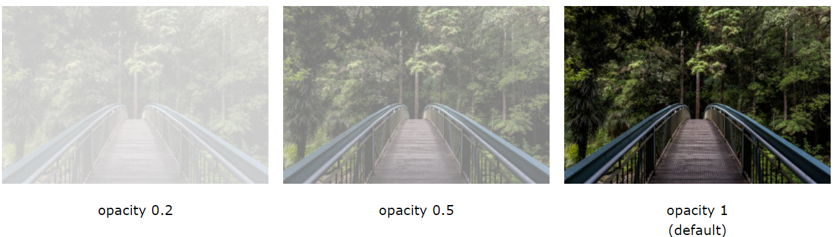
CSS Opacity/Transparency
The opacity property specifies the opacity/transparency of an element.
The opacity property can take a value from 0.0 - 1.0.
https://www.w3schools.com

Slide 84
CSS Opacity/Transparency
<!DOCTYPE html>
<html>
<head>
<style>
img {
opacity: 0.5;
}
img:hover {
opacity: 1.0;
}
</style>
</head>
<body>
<h1>Image Transparency</h1>
<p>The opacity property is often used together with the :hover selector to change the opacity on mouse-over:</p>
<img src="Aus-kangaroo.jpg" alt="Kangaroo" width="170" height="100">
<img src="Aus-Koala.jpg" alt="Koala" width="170" height="100">
<img src="Aus-Uluru.jpg" alt="Uluru" width="170" height="100">
</body>
</html>
https://www.w3schools.com

Slide 85
CSS Gradients
CSS gradients let you display smooth transitions between two or more specified colors.
Syntax
background-image: linear-gradient(direction, color-stop1, color-stop2, ...);
Direction
Top to Bottom (this is default)
Left to Right
https://www.w3schools.com

Slide 86
CSS Gradients – Example 1
<!DOCTYPE html>
<html>
<head>
<style>
#grad1 {
height: 200px;
background-image: linear-gradient(to right, red , yellow);
}
</style>
</head>
<body>
<h1>Linear Gradient - Left to Right</h1>
<p>This linear gradient starts red at the left, transitioning to yellow (to the right):</p>
<div id="grad1"></div>
</body>
</html>
https://www.w3schools.com

Slide 87
CSS Gradients – Example 2
<!DOCTYPE html>
<html>
<head>
<style>
#grad1 {
height: 200px;
background-image: linear-gradient(to bottom right, red, yellow);
}
</style>
</head>
<body>
<h1>Linear Gradient - Diagonal</h1>
<p>This linear gradient starts red at top left, transitioning to yellow (at bottom right):</p>
<div id="grad1"></div>
</body>
</html>
https://www.w3schools.com

Slide 88
CSS Gradients – Example 3
<!DOCTYPE html>
<html>
<head>
<style>
#grad1 {
height: 55px;
background-image: linear-gradient(to right, red, orange, yellow, green, blue, indigo, violet);
}</style>
</head>
<body>
<div id="grad1" style="text-align:center;margin:auto;color:Grey;font-size:40px;font-weight:bold">
Rainbow Background
</div>
</body>
</html>
https://www.w3schools.com

Slide 89
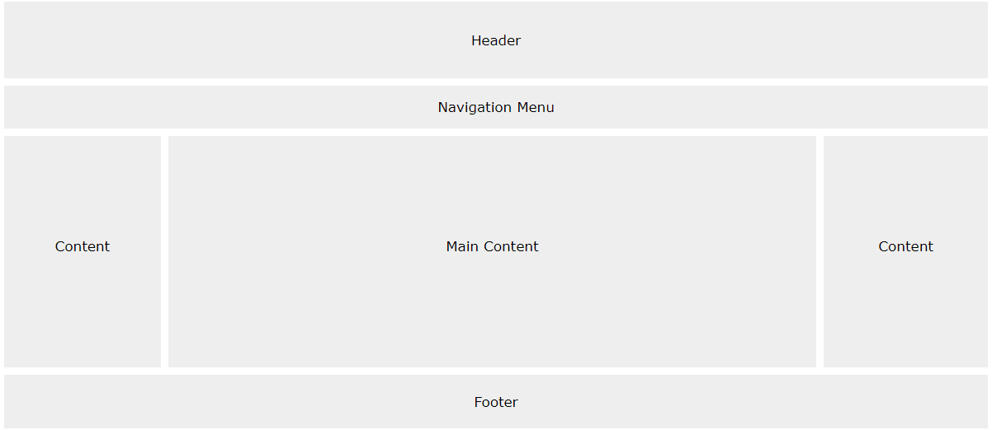
Website Layout
A website is often divided into headers, menus, content and a footer
https://www.w3schools.com

Slide 90
Website Layout - Example (1 of 2)
<!DOCTYPE html>
<html>
<head>
<title>
Website Layout
</title>
<style>
* {
box-sizing: border-box; }
/* CSS property for header section */
.header {
background-color: green; padding: 15px; text-align: center; }
/* CSS property for nevigation menu */
.nav_menu {
padding: 30px; background-color: black;}
.nav_menu a { display: inline; color: white; text-align: center; padding: 14px 16px; text-decoration: none; }
.nav_menu a:hover { background-color: white; color: green; }
/* CSS property for content section */
.columnA, .columnB, .columnC {
float: left;
width: 31%;
padding: 15px;
text-align:justify; }
h2 { color:green;
text-align:center;
}
.footer {
position: fixed; padding: 15px;
left: 0;
bottom: 0; width: 100%;
background-color: red;
color: white;
text-align: center;}
</style> </head> <body>
https://www.w3schools.com

Slide 91
Website Layout - Example (2 of 2)
<!-- header of website layout -->
<div class = "header">
<h2 style = "color:white;font-size:200%"> Website Layout </h2>
</div>
<!-- nevigation menu of website layout -->
<div class = "nav_menu">
<a href = "#">Algo</a>
<a href = "#">DS</a>
<a href = "#">Language</a>
</div>
<div class = "columnA">
<h2>Column A</h2> <p>Some text.Some text.Some text.Some text.Some text.Some text.Some text.Some text.Some text.Some text.</p> </div>
<div class = "columnB">
<h2>Column B</h2>
<p>Some text.Some text.Some text.Some text.Some text.Some text.Some text.Some text.Some text.Some text.</p> </div>
<div class = "columnC">
<h2>Column C</h2>
<p>Some text.Some text.Some text.Some text.Some text.Some text.Some text.Some text.Some text.Some text.</p> </div>
<!-- footer Section -->
<div class = "footer">
<a href = "#">About</a>
<a href = "#">Career</a>
<a href = "#">Contact Us</a>
</div>
</body>
</html>
https://www.w3schools.com

Slide 92
Any Questions?

